Slide 1




Bitcoin Price Trends With Indicators (9Years)
ASEEL ALGHAMDI
MISFER ALGOSA

Slide 2



Data Set
We utilized scrolling functionality to gather data spanning the past 9 years on Bitcoin prices from the Coingecko website, subsequently analyzing the dataset. The collected data comprises
9
20
Years
column

Slide 3
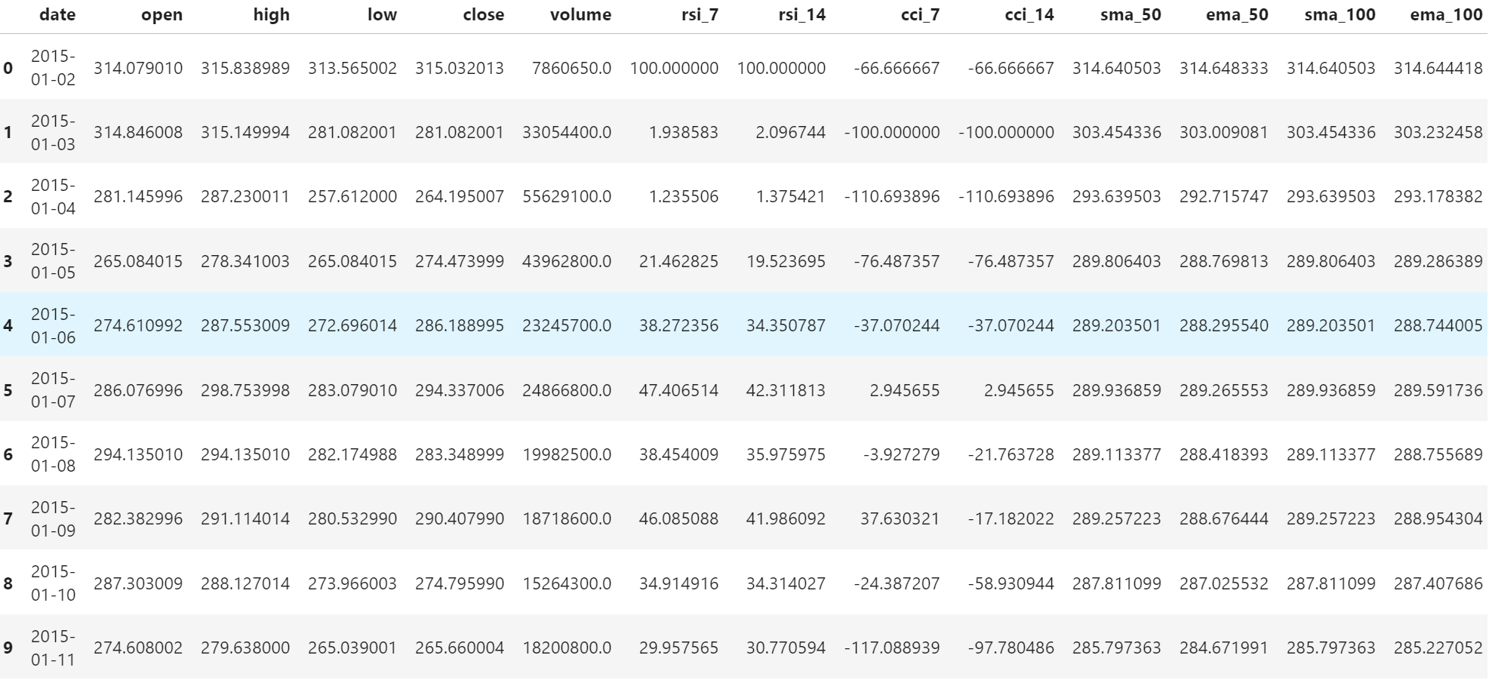
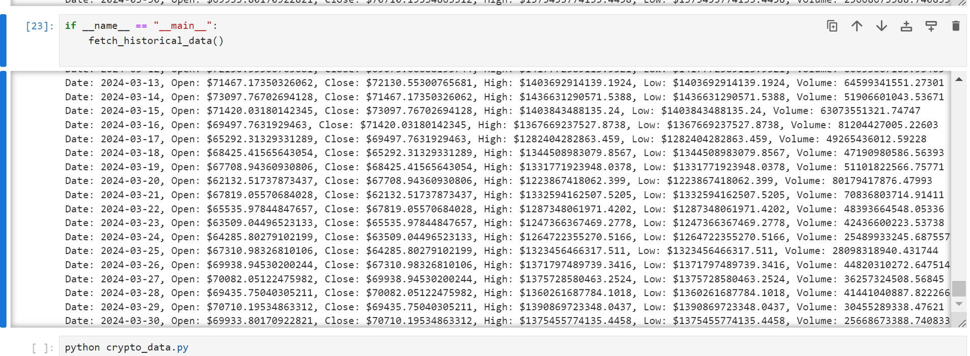

Slide 4
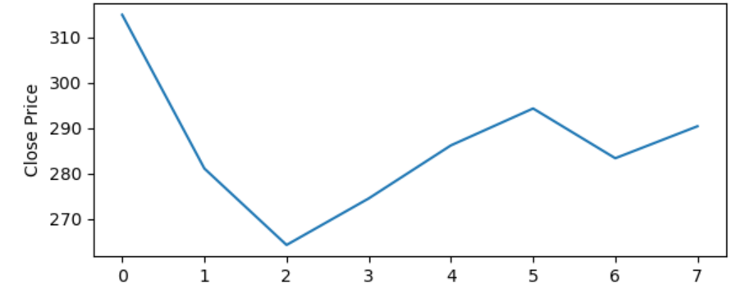
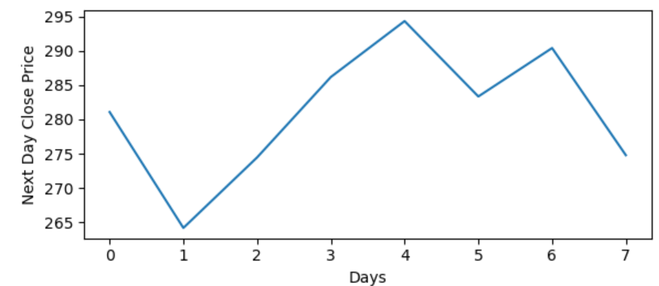
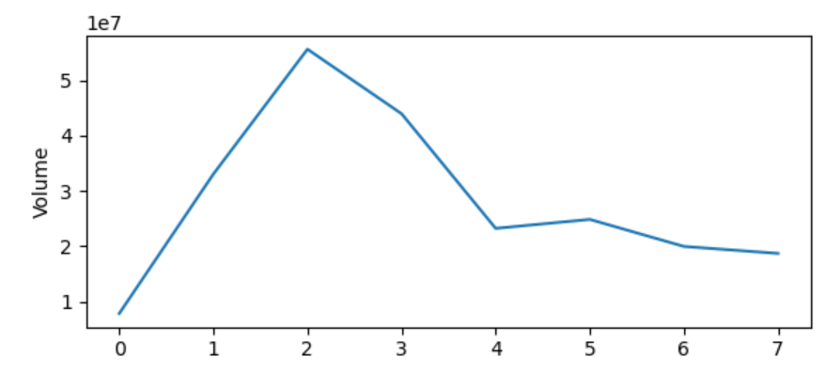
1
3
2

Slide 5

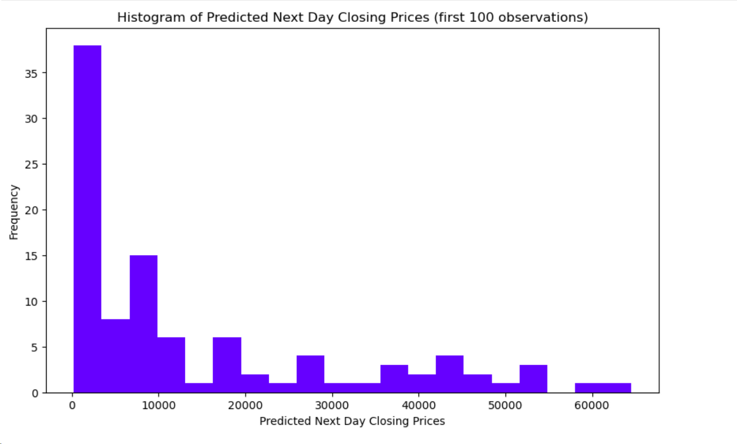
Use machine learning histogram to predicted next day closing prices for the 100 entries in the test data

Slide 6
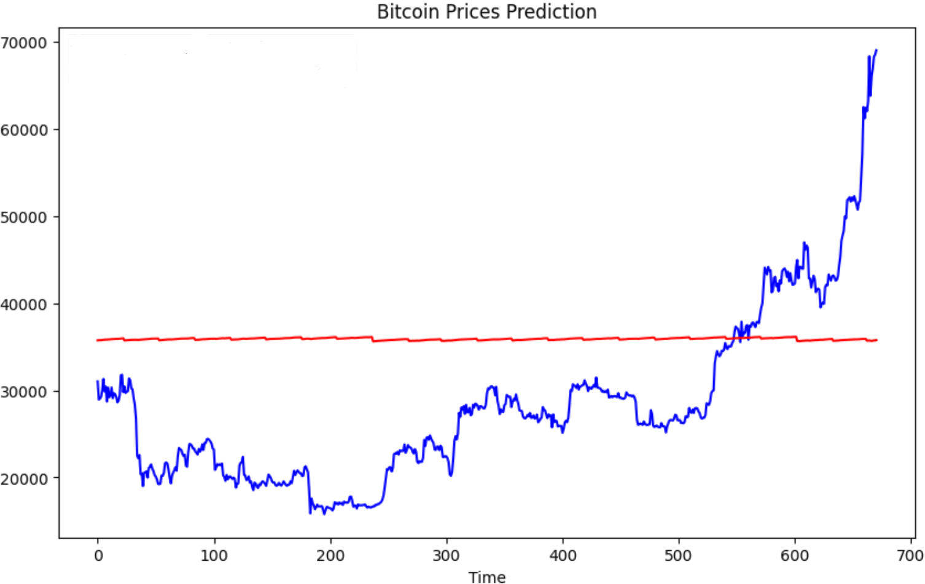

Slide 7

Thank You
For Watching

